Slide 1
Photoactivated Localization Microscopy (PALM)
Physics 305 Computational Imaging
Superresolution

Slide 2
What’s needed for PALM
OPTICS side
Photoactivatable fluorescent dyes
Widefield fluorescent microscope – a Total Internal Reflection Microscope
A means to switch on and off an activation and readout laser
A highly sensitive CCD camera
IMAGE PROCESSING side
Gaussian fitting
Stacking of images

Slide 3
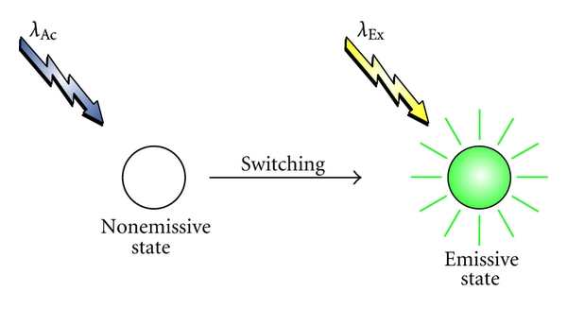
Photoactivated molecular dye
Figure from Reg [6]

Slide 4
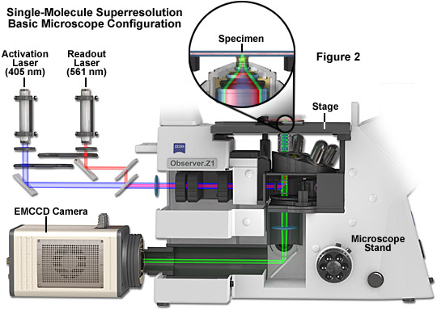
Total Internal Reflection Microscope
Figure from [3]

Slide 5
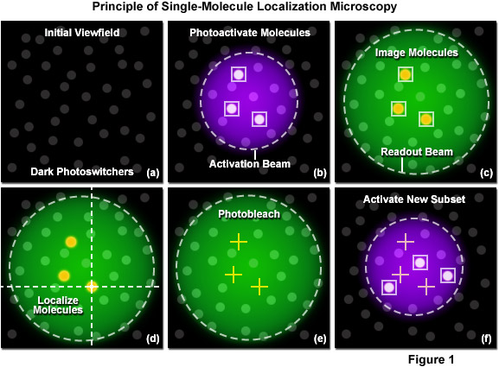
Figure from Ref [4]

Slide 6
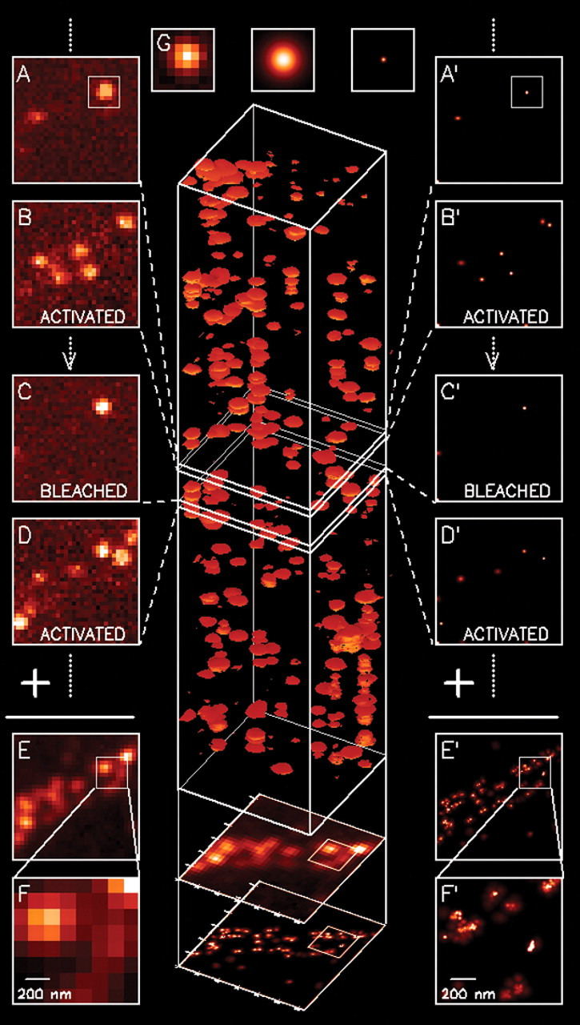
Priciple behind PALM. Figure from Ref [1]
The activation-excitation-bleaching cycle is done thru time.
For overlapping cells, differentiation can also be done thru wavelength by using multiple photoactivated dyes.

Slide 7
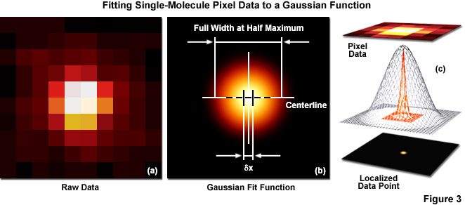
Fitting a Gaussian to a Fluorescent Burst
Figure from Ref [4]

Slide 8
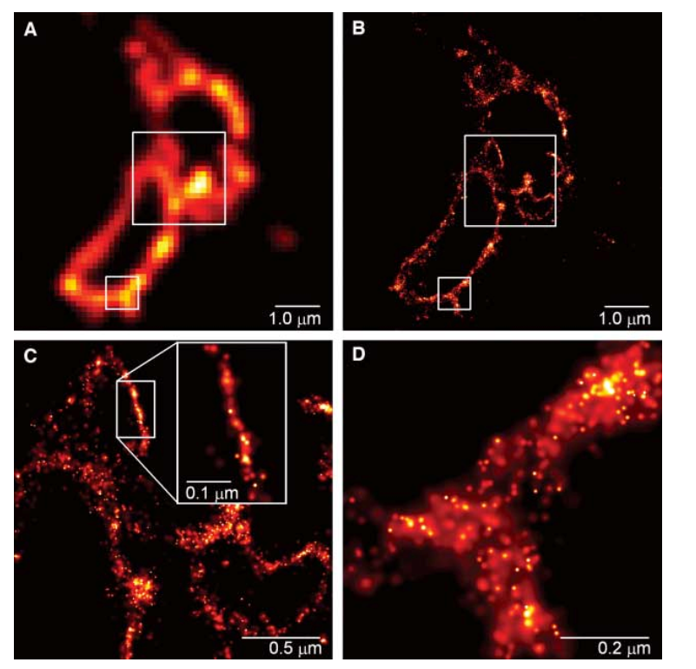
Results
COS-7 cells from a monkey’s kidney.
Figure from Ref [1]

Slide 9
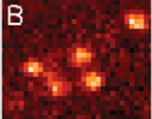
Activity
Superresolve the image on the right by fitting 2D Gaussians on the bright spots. (Figure from Ref [1])
You may use available multivariate normal distribution fitting routines.
You may also use Expectation Maximization Gaussian Mixture Models

Slide 10
References
[1] Betzig, E., Patterson, G. H., Sougrat, R., Lindwasser, O. W., Olenych, S., Bonifacino, J. S., ... & Hess, H. F. (2006). Imaging intracellular fluorescent proteins at nanometer resolution. science, 313(5793), 1642-1645.
[2]Mortensen, K. I., Churchman, L. S., Spudich, J. A., & Flyvbjerg, H. (2010). Optimized localization analysis for single-molecule tracking and super-resolution microscopy. Nature methods, 7(5), 377-381.
[3] ZEISS Microscopy Online Campus | Introduction to Photoactivated Localization Microscopy (PALM) (fsu.edu)
[4] ZEISS Microscopy Online Campus | Practical Aspects of Photoactivated Localization Microscopy (PALM) (fsu.edu)
[6] Françisco M. Raymo, "Photoactivatable Fluorophores", International Scholarly Research Notices, vol. 2012, Article ID 619251, 15 pages, 2012. https://doi.org/10.5402/2012/619251

